Slide 1
Splufic Python Training
Welcome to the instructor-led Training for week two day three

Slide 2
Topics Covered (Cont’d From Day 2)
Identifiers, Variables, operators, expressions and assignments
Basic data types (Boolean, int, float, string)
The list container type
Implicit and Explicit type conversion
1-way and 2-way conditional statements

Slide 3
Variables
A variable is like a container that stores values that you can access or change.
It is a way of pointing to a memory location used by a program.
You can use variables to instruct the computer to save or retrieve data to and from this memory location.
It helps us to uniquely identify and differentiate a variable from another

Slide 4
variable names: naming convention
An identifier can be a combination of uppercase letters, lowercase letters, underscores, hyphen and digits (0-9).
variable names cannot start with numbers
Special characters such as %, @, and $ are not allowed
whenever a variable is Constant, use capital case
variable names should be specific and detailed
Python is a case-sensitive language and this behavior extends to identifiers
You cannot use Python keywords as identifiers.

Slide 5
Variable Declaration, Initialization and Assignment
A variable is declared when it is given a name
A variable is initialized when it is assigned a value for the first time
The general format of an assignment statement is: <variable> = <expression>
In python, variables are declared and initialized at the same time
E.g.:
name = 'victor'
print(type(name))

Slide 6
Data Types
Number
Boolean
String
Containers
List
Tuple
Set

Slide 7
Numbers
Integer or whole numbers: e.g. int
Whole or regular: 2
Binary (base 2): 0b10
Octal (base 8): 0o2
Hexadecimal (base 16): 0x2
Decimal or fractional: float
Complex numbers

Slide 8
Booleans
Booleans are defined by bool
Booleans holds only two values
False
True
may be used to check if a string is empty or not
May also be used to test if a number is zero or not

Slide 9
Strings
A string is a sequence of Unicode characters that may be a combination of letters, numbers, and special symbols.
To define a string in Python, you can enclose the string in matching single or double quotes:
E.g.:
string1 = ‘I am enclosed in single quotes.’
string2 = “I am enclosed in double quotes.”
String3 = ‘don’t do this’

Slide 10
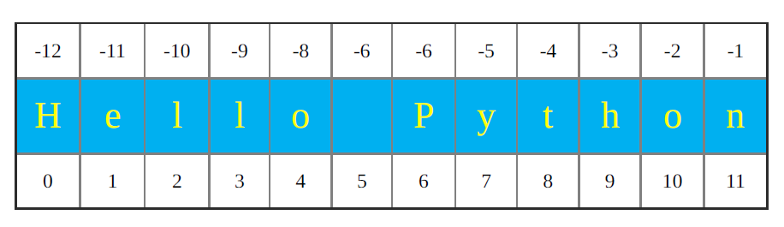
String Indexing
Strings may be indexed or subscripted. In Python, indexing starts from 0 (zero) instead of 1.
Hence, a string’s first character has a zero index.
>>> s = “Hello Python”

Slide 11
Basic String Functions/operations
Addition: +
Multiplication: *
Check if a string contains a letter or another string: ‘a’ in ‘abs’ , ‘a’ not in ‘abs’
Len(s): used to get the length of a string
lower(s): converts a string to lower case
upper(s): converts a string to upper case
str(): makes strings out of non-strings character(s).

Slide 12
Slicing Strings
You can create substrings with the slicing notation.
You can do this by placing two indices (separated by a colon) within square brackets.
The first index marks the start of the substring while
The second index indicates the index number of the first character you don’t want to include in the substring.
To slice strings, use the format: [start : end]

Slide 13
Class Work 1
Start by executing the assignment statements:
>>> s1 = 'ant'
>>> s2 = 'bat'
>>> s3 = 'cod'
Write Python expressions using s1, s2, and s3 and operators + and * that evaluate to:
(a) 'ant bat cod'
(b) 'ant ant ant ant ant ant ant ant ant ant '
(c) 'ant bat bat cod cod cod'
(d) 'ant bat ant bat ant bat ant bat ant bat ant bat ant bat '
(e) 'batbatcod batbatcod batbatcod batbatcod batbatcod '

Slide 14
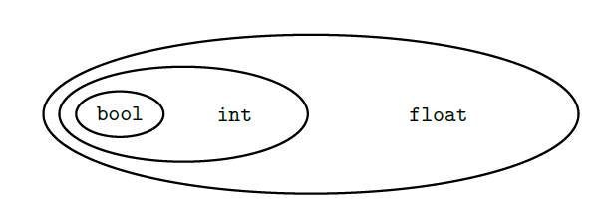
Type Conversion
Implicit Conversion: If an algebraic or logical expression involves operands of different types, Python will convert each operand to the type that contains the others.
Explicit conversion
int()
float()
complex()
str()

Slide 15
Lists and Tuples
A list is a sequence of objects separated by commas and enclosed in brackets ([ ]):
Lists help us organize data into a list:
a shopping list,
a list of courses,
a list of contacts on your cell phone,
a list of songs in your audio player, and so on.
The objects in a list can be of any type: numbers, strings, even other lists.
A tuple object contains a sequence of values separated by commas and enclosed in parentheses (( )) instead of brackets ([ ])

Slide 16
Lists Cont’d
To create an empty list in python, use
list()
[]
You can also make a list with some initial values:
Shopping = [‘shoes’, ‘clothes’]
Lists can contain other lists
E.g: things = ['one', 2, [3, 4]]
Lists are mutable: its content can be changed
Tuples behave like lists except that tuples are immutable.

Slide 17
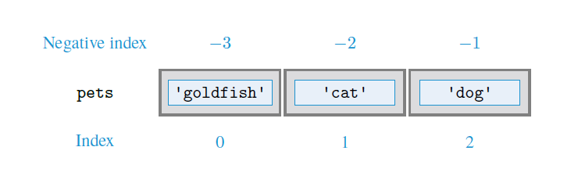
List Indexing
Consider the example:
pets = ['goldfish', 'cat', 'dog’]
The index notation is given below

Slide 18
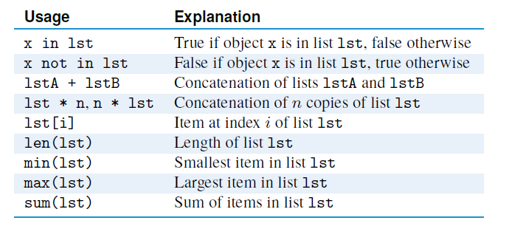
List Operators
Some basic list operation is given below:

Slide 19
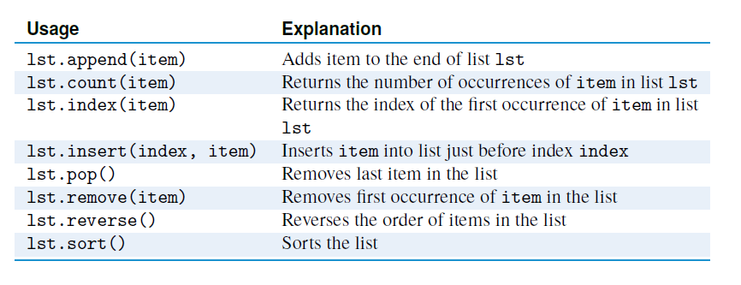
List Methods

Slide 20
Class Work 2
Given the list of student homework grades
>>> grades = [9, 7, 7, 10, 3, 9, 6, 6, 2]
write:
(a) An expression that evaluates to the number of 7 grades
(b) A statement that changes the last grade to 4
(c) An expression that evaluates to the maximum grade
(d) A statement that sorts the list grades
(e) An expression that evaluates to the average grade

Slide 21
Slicing lists
You can also slice lists in the same way that you slice strings.
To slice lists, use the format: [start : end]
E.g:
colors = [“red”, “orange”, “yellow”, “green”, “indigo”, “white”]
colors[3:6]

Slide 22
Questions?

